Slide 1
Unit IV
Memory Management

Slide 2
Agenda
Contiguous and non-contiguous
Swapping
Paging
Segmentation and demand paging
Virtual memory
Management of virtual memory
  Allocation
  Fetch
  Replacement

Slide 3
Objectives
To provide a detailed description of various ways of organizing memory hardware
To discuss various memory-management techniques, including paging and segmentation
To provide a detailed description of the Intel Pentium, which supports both pure segmentation and segmentation with paging

Slide 4
Memory Management
MM include
  memory allocation and deallocation,
  efficient utilization of memory and
  protection of memory allocated to program and process.

Slide 5
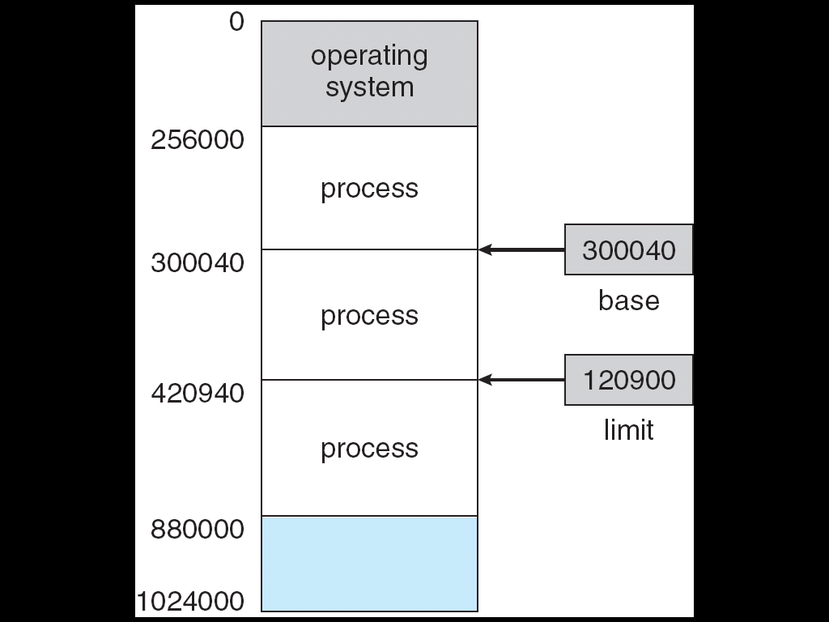
Base and Limit Registers
A pair of base and limit registers define the logical address space

Slide 6
Address Binding
Address binding of instructions and data to memory addresses can happen at three different stages
  Compile time: If at the compile time process will reside in memory ,then absolute code can be generated; must recompile code if starting location changes

Slide 7
  Load time: if it is not known at compile time where the process will reside in the memory, then Must generate relocatable code, if the starting address changes, need to reload the user code to incorporate this changes values
  Execution time: Binding delayed until run time if the process can be moved during its execution from one memory segment to another. Need hardware support for address maps (e.g., base and limit registers)

Slide 8

Multi step Processing of a User Program

Slide 9
Logical address & physical address
CPU commonly referred to as a logical address where as an address seen in memory unit, that is loaded into memory address register of the memory, referred as Physical address
The compile time and load time address binding methods generates identical and physical addresses.
Execution time address binding scheme result in differing logical and physical address, logical address as a virtual address.

Slide 10
The set of all logical address generated by a program is a logical address space.
The set of all physical address corresponding to these logical addresses is a physical address space.
The run time mapping from virtual to physical address is done by a hardware device called memory management unit (MMU).

Slide 11

Dynamic relocation using a relocation register

Slide 12
Dynamic loading
Program and data of a process must be in the physical memory for the process to execute.
The size of process is thus is limited the size of physical memory, to obtained better memory space utilization use dynamic loading
Dynamic loading does not require special support from the operating system.
OS may help the programmer by providing library routine to implements dynamic loading.

Slide 13
Dynamic Linking & Shared Libraries
?

Slide 14
Contiguous Memory allocation
Main memory accommodate both the OS and various user process
Memory is divided into two partitions
  Resident operating System
  User process
Several user process to reside in the memory at the same time.
In contiguous memory allocation each process is contained in a single contiguous section of memory.

Slide 15
Memory Mapping & Protection
Memory Allocation
Fragmentation

Slide 16
Memory allocation
Simplest way to allocating memory is diving memory into several fixed sized of partitions.
Each partition may contain exactly one process.
In multi partition method, when partition is free, the process is selected from input queue and loaded into the free partitions. When the process is terminated, the partitions becomes available for another process

Slide 17
Multiple-partition allocation
  Hole – block of available memory; holes of various size are scattered throughout memory
  When a process arrives, it is allocated memory from a hole large enough to accommodate it
  Operating system maintains information about:
  a) allocated partitions b) free partitions (hole)
OS
OS
OS
OS
process 5
process 5
process 5
process 5
process 9
process 9
process 8
process 10
process 2
process 2
process 2
process 2

Slide 18
Dynamic Storage-Allocation Problem
How to satisfy a request of size n from a list of free hole
First fit :- Allocates the first hole that is big enough.
searching can starts either at the beginning of the set of hole or where previous first fit search ended.

Slide 19
Best fit :- Allocate the smallest hole that is big enough; must search entire list, unless ordered by size
Worst-fit: Allocate the largest hole; must also search entire list
  Produces the largest leftover hole

Slide 20
In the fixed partition scheme, the overrating system keeps a table indicating which parts of memory are available and which are occupied

Slide 21
Fragmentation
External Fragmentation – total memory space exists to satisfy a request, but it is not contiguous
Internal Fragmentation – allocated memory may be slightly larger than requested memory; this size difference is memory internal to a partition, but not being used
Reduce external fragmentation by compaction
  Shuffle memory contents to place all free memory together in one large block
  Compaction is possible only if relocation is dynamic, and is done at execution time
  I/O problem
    Latch job in memory while it is involved in I/O
    Do I/O only into OS buffers

Slide 22


Slide 23

Swapping

Slide 24
Swapping
A process must be in memory to be execute.
A process can be swapped temporarily out of memory to a backing store and then brought back into memory for continued execution
For ex :- multiprogramming environment with RR cpu scheduling algo. When a quantum is expires, the memory manager will start to swap out the process that just finished and to swap another process into the memory space.

Slide 25
Roll out, roll in
A variant of this swapping policy is used for priority based scheduling algo.
If higher priority process is arrives and wants service, the memory manager swap out the lower priority process and then load and execute the higher priority process. When higher priority process finishes, the lower priority process can be swapped back in and continued. This variant of swapping is called roll out, roll in.

Slide 26
Normally, process that is swapped out will be swapped back into same memory space it occupied previously
This is because method of address binding

Slide 27
Paging
Paging is memory management scheme that permits the physical address of space of a process to be noncontiguous
Paging avoids the considerable problem of fitting memory chunks of varying size onto the backing store.
Paging has been handled by hardware.
Paging closely integrating the hardware and operating system, especially on 64 bit microprocessor

Slide 28
The basic method for implementing paging involves breaking physical memory into fixed size blocks called frames.
Breaking logical memory into block of same size called pages.
When a process is to be executed, its page are loaded into any available memory frames from the backing store.
The backing store is divided into fixed size blocks that are same size as the memory frames.

Slide 29

Basic Method for paging

Slide 30
Every address generated by CPU is divided into two parts
  Page Number (p)
  Page Offset (d)
The page number is used as an index into page table.
The page table contains base address of each in page in physical memory.
This base address is combined with page offset to define the physical memory address that is sent to the memory unit.

Slide 31

The page size is defined by the hardware the size of a page is typically power of 2 , varying between 512 bytes and 16 MB per page.

Slide 32

Paging Example

Slide 33
Protection
Memory protection in a paged environment is accomplished by protection bits associated with each frame, these bits are kept in page table.
One bit can define a page to be read –write or read only.
Every reference goes to the page table to find the correct frame number.
At the same time physical address is being computed, the protection bits are checked to verify that no writes are being made to read only page, to write to a read only page cause the hardware trap the operating system or memory
protection.

Slide 34

Valid (v) or invalid bit in a page table.

Slide 35
Protection (cont.)
H/w provide read only and read-write or execute only protection.
Providing separate protection bit for each kind of access.
One additional bit is generally attached with to each entry in the page table valid or invalid.
When the bit is valid the associated page is in the process’s logical address space is legal page.
When the bit is invalid the page is not is in the process’s logical address space.
The OS sets the each page allow or disallow access to the page.

Slide 36
Shared pages
Advantage of paging is the possibility of sharing common code.
Shared code
  One copy of read-only (reentrant) code shared among processes (i.e., text editors, compilers, window systems).
  Shared code must appear in same location in the logical address space of all processes
Private code and data
  Each process keeps a separate copy of the code and data
  The pages for the private code and data can appear anywhere in the logical address space

Slide 37
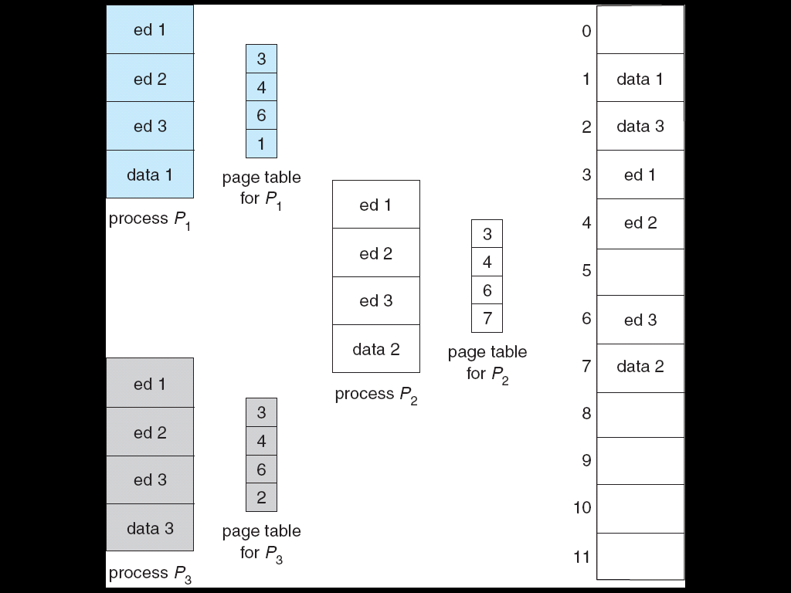
Sharing of code in a paging environment

Slide 38
Structure of the Page Table
Hierarchical Paging
Hashed Page Tables
Inverted Page Tables

Slide 39
Hierarchical Page Tables
Most modern system support a logical address space (2³² to 2⁶⁴)
In that environment, the page table is excessively large.
for ex consider a system 32 bit logical address space. If the page size of in system is 4 KB then a page table may consist of up to 1 million entries,

Slide 40

Two level paging

Slide 41
Page table is itself page
A logical address (on 32-bit machine with 1K page size) is divided into:
  a page number consisting of 22 bits
  a page offset consisting of 10 bits
Since the page table is paged, the page number is further divided into:
  a 12-bit page number
  a 10-bit page offset
Thus, a logical address is as follows:
where p_{i} is an index into the outer page table, and p₂ is the displacement within the page of the outer page table
page number
page offset
p_{i}
p₂
d
12
10
10

Slide 42
Segmentation
Segmentation is a memory management scheme supporting user’s view of memory.

